Slide 1

The analysis of
Weather indices and
Environmental factors in canada
Bernard Bernabeo Gurnoor Kaur
Kevin Chan
Khulan Jambalsuren

Slide 2
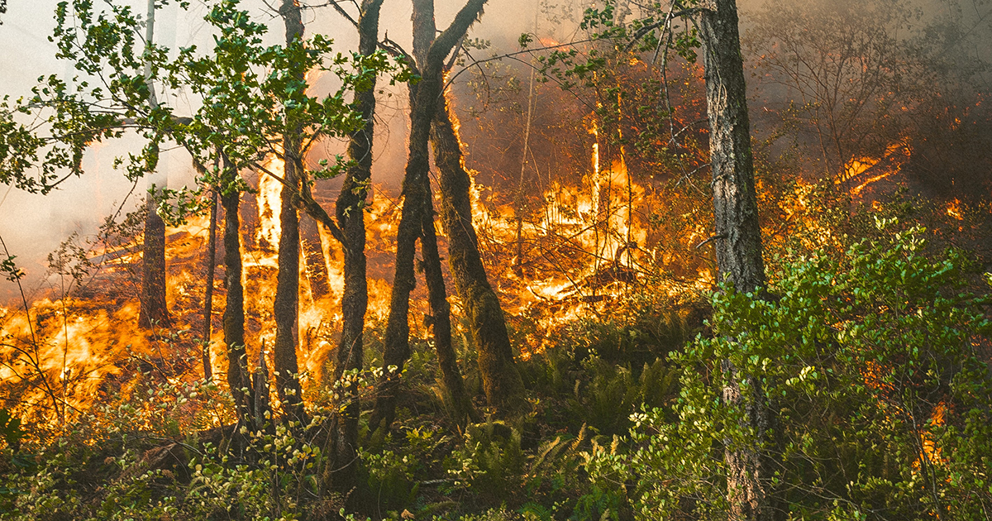

Data set
Content: 10-year data of environmental variables and wildfire indices
Geography:
Across Canada and the U.S.
Collection:
Satellite imagery, remote sensing, weather monitoring and reports
Source: BC Wildfire Service
Page. 2

Slide 3
Data cleaning
Removed rows outside Canada (10 provinces and 3 territories)
Removed inconsistent and unnecessary variables
Reformat the dates
Drop of NULL values in computation of averages
Page. 3

Slide 4
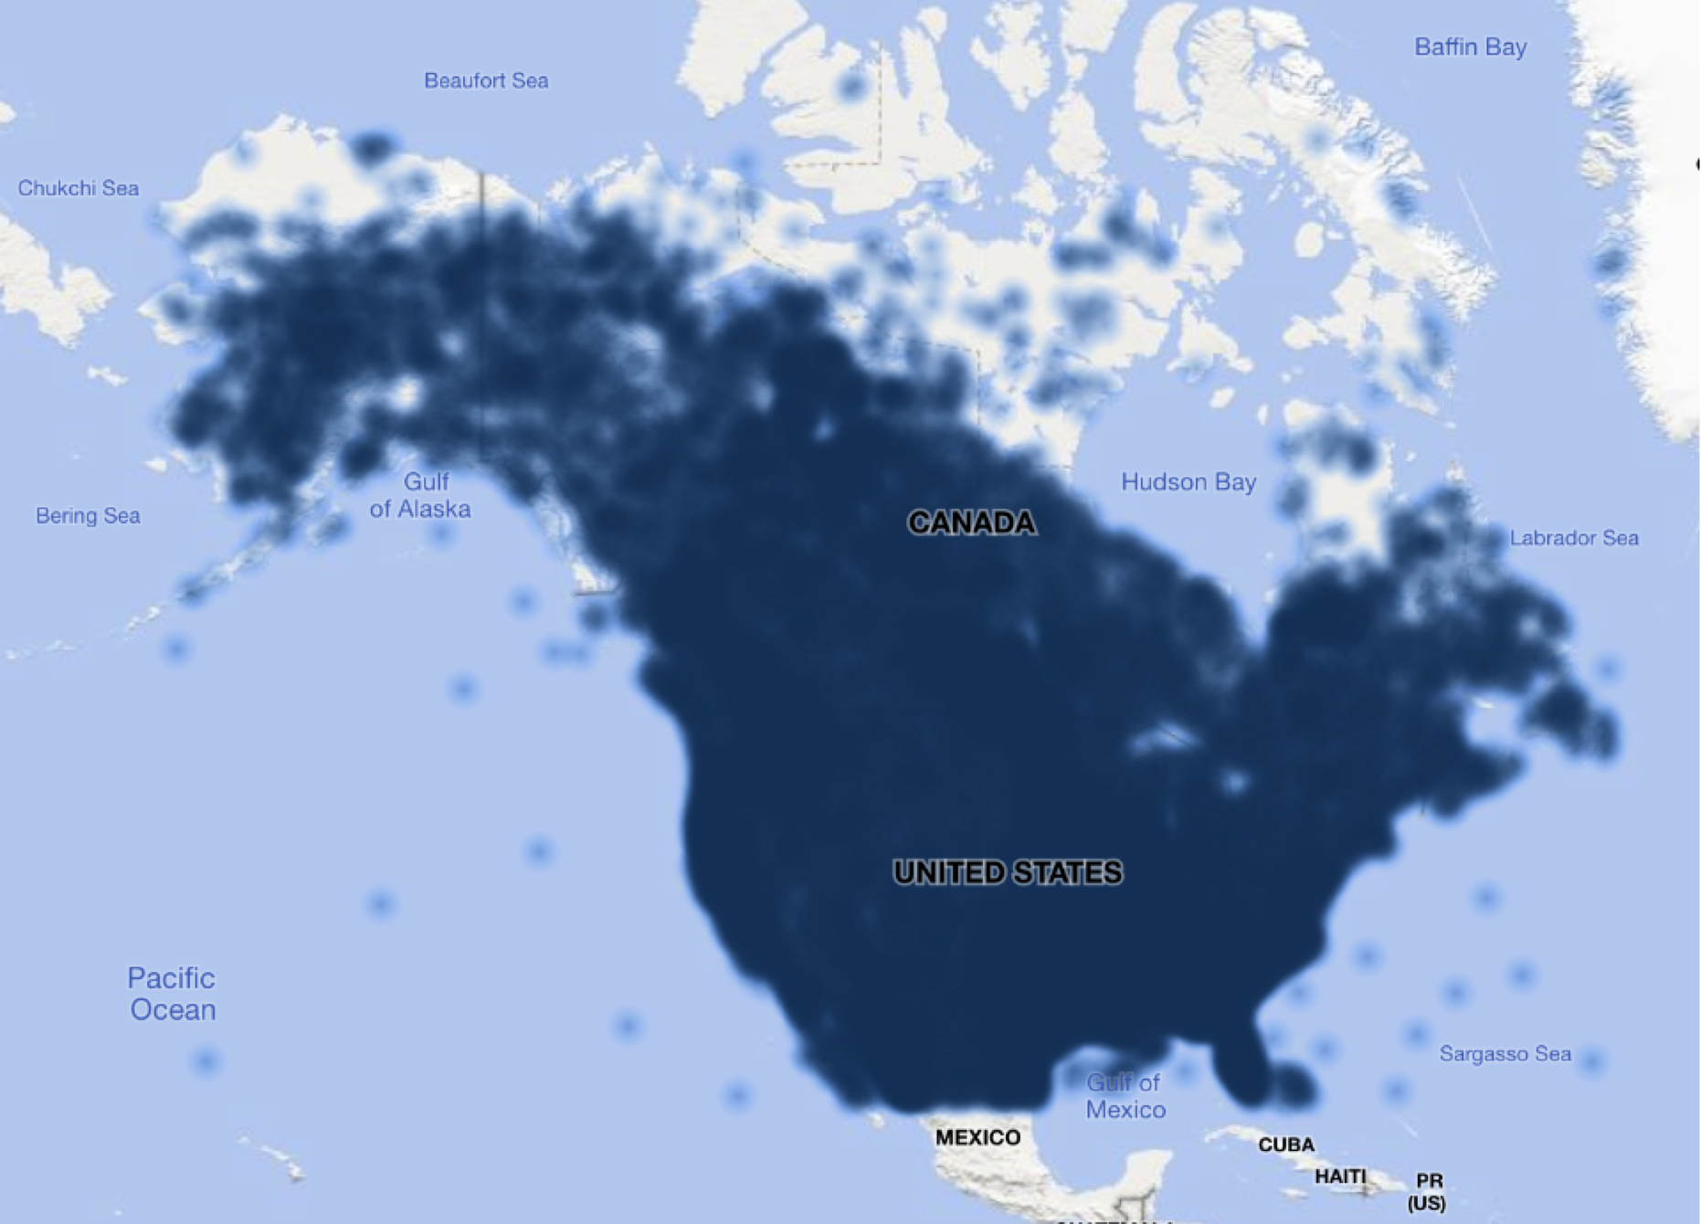
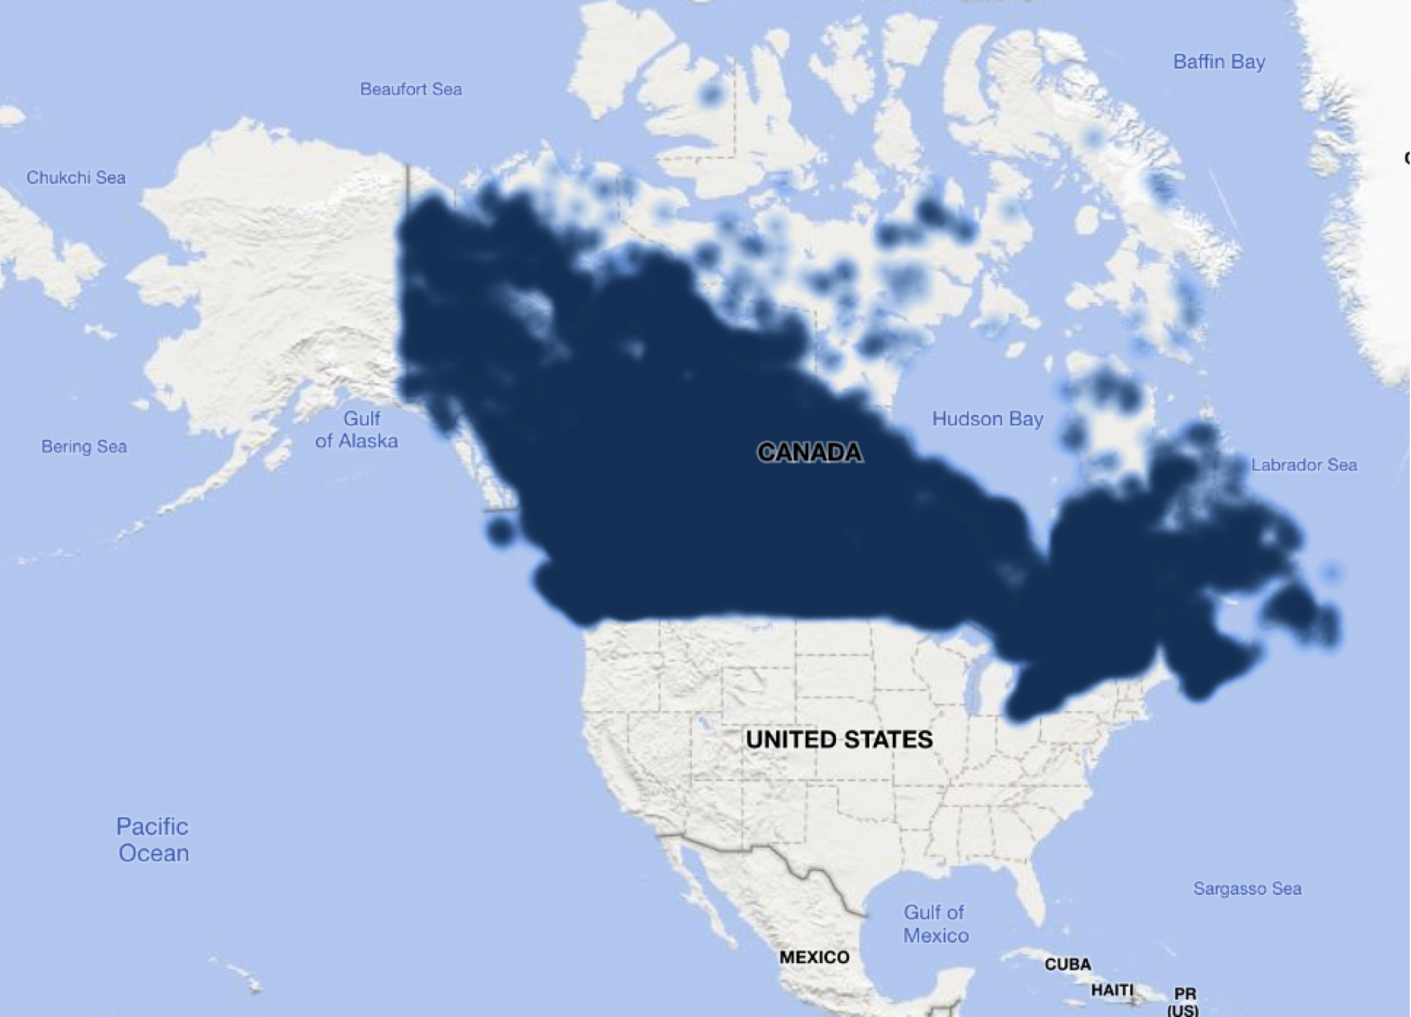
Geography: In canada
Original data set
39 variables
7,464,062 rows
Cleaned data set
27 variables
3,865,702 rows
Page. 4

Slide 5
variables
Temp – Temperature
RH – Relative Humidity
WS – Wind Speed
PCP – 24hr Precipitation
FWI – Fire Weather Index
ISI – Initial Spread Index
BUI – Build-up Index
FFMC – Fine Fuel Moisture Code
DMC – Duff Moisture Code
DC – Drought Code
e
Page. 5
Notes:
Fine Fuel Moisture Code
The Fine Fuel Moisture Code (FFMC) is a numeric rating of the moisture content of litter and other cured fine fuels. This code is an indicator of the relative ease of ignition and the flammability of fine fuel.
Duff Moisture Code
The Duff Moisture Code (DMC) is a numeric rating of the average moisture content of loosely compacted organic layers of moderate depth. This code gives an indication of fuel consumption in duff layers (2-4 inches) deep and medium-sized woody material.
Drought Code
The Drought Code (DC) is a numeric rating of the average moisture content of deep, compact organic layers. This code is a useful indicator of the effects of seasonal drought on forest fuels and the amount of smouldering that may occur in deep duff layers and within large logs.
Initial Spread Index
The Initial Spread Index (ISI) is a numeric rating of the expected rate of fire spread. It is based on the wind speed and the FFMC. Like the rest of the FWI system components, the ISI does not take fuel types into account. Actual spread rates vary between fuel types.
Buildup Index
The Buildup Index (BUI) is a numeric rating of the total amount of fuel available for combustion on the landscape. It is based on the Duff Moisture Code and the Drought Code, thus taking into account the moisture content of medium-sized to large-sized woody material as well as the effects of seasonal drought on forest fuels. The BUI is used by the BC Wildfire Service to decide when to implement a campfire (Category 1) ban.
Multiple factors are taken into consideration when assessing wildfire hazards and deciding whether to implement an open fire prohibition, including:
current and forecasted weather conditions;
the availability of firefighting resources; and
the Buildup Index (BUI).

Slide 6


Exploratory
Data analysis
Fire Weather Index (FWI)
Build-up Index (BUI)
Initial Spread Index (ISI)
Page. 6

Slide 7
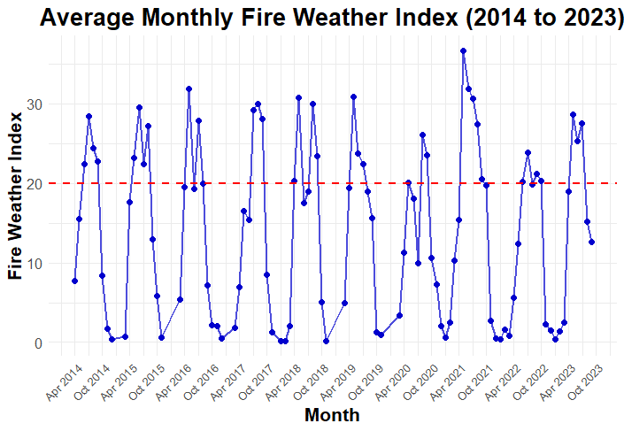
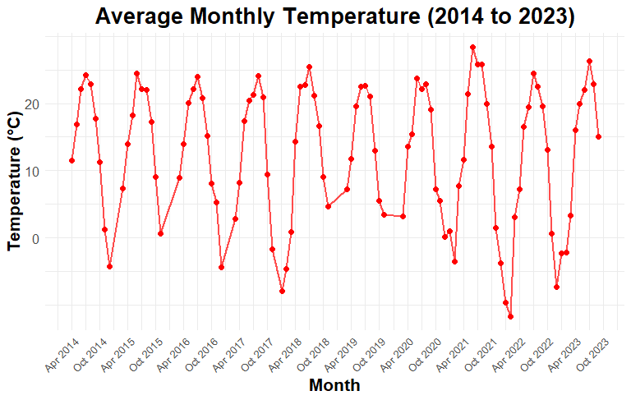
Time series of fire weather index (FWI)
Time series of Temperature (°C)
Page. 7

Slide 8
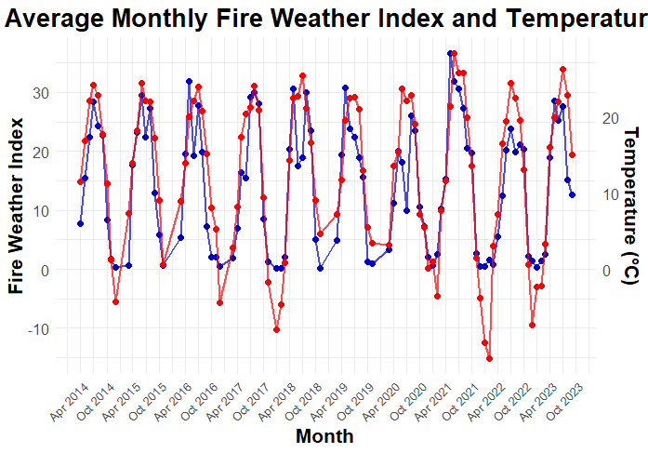
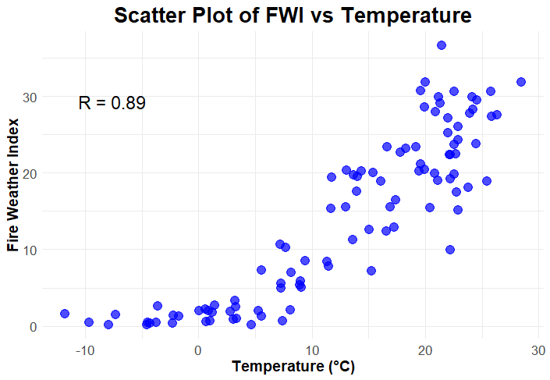
Time series of FWI vs. Temperature
Scatter Plot of FWI vs. Temperature
Page. 8

Slide 9
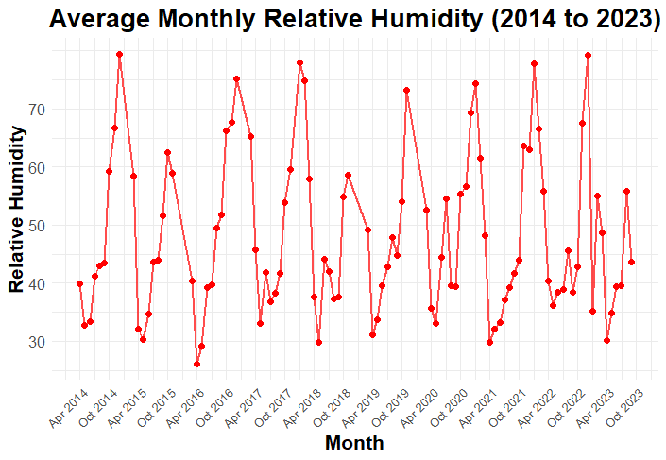
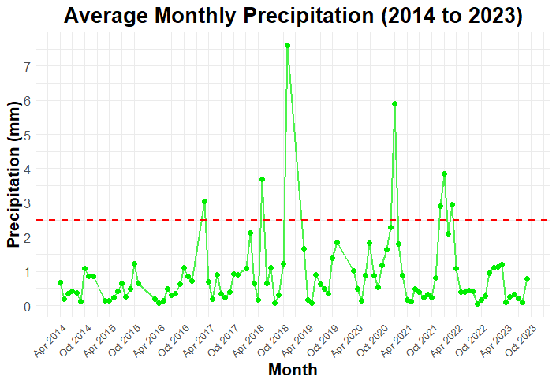
Time series of fire weather index (FWI)
Time series of Relative Humidity
Time series of Precipitation (mm)
Page. 9

Slide 10
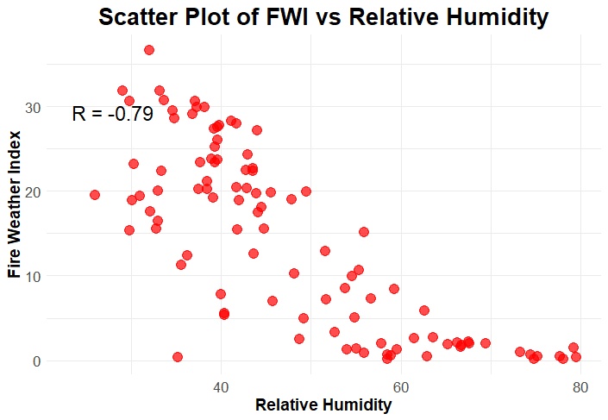
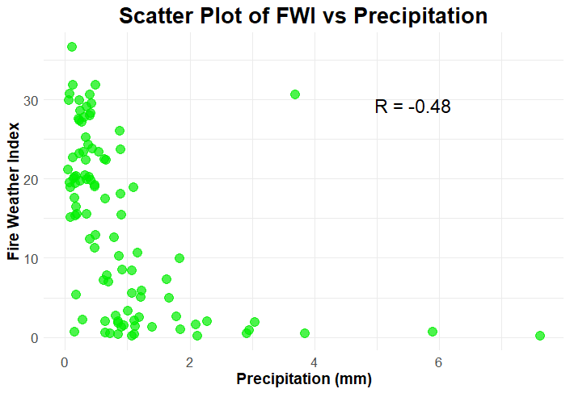
Scatter plots for FWI vs. Humidity/precipitation
Page. 10

Slide 11

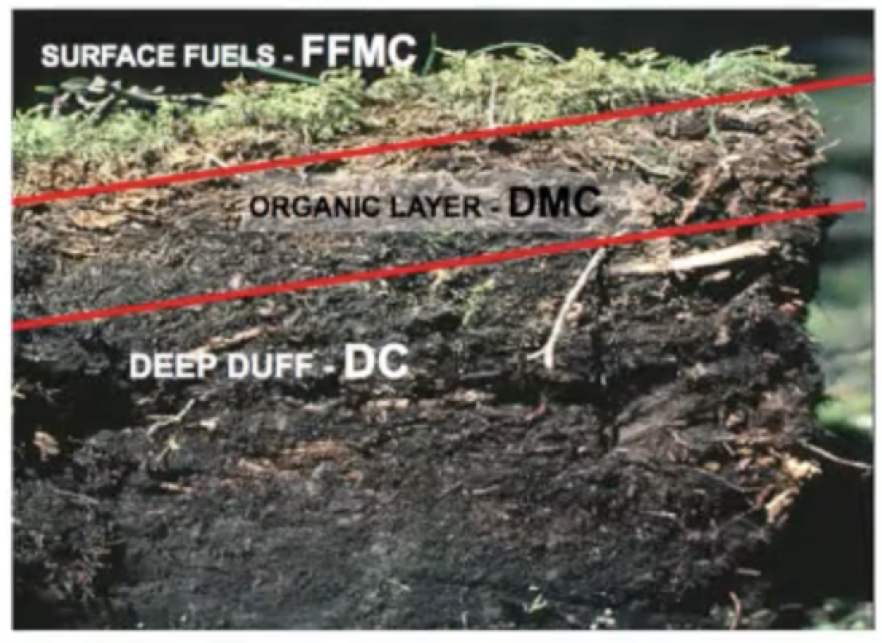
Soil components: FFmc, dmc, DC
wet
dry
Page. 11
Notes:
Photo credits: Photo of effect of slope in WS from Northwest Knowledge Hub ​
https://www.youtube.com/watch?v=4onekaD-J8M​
BUI is a numeric rating of the total amount of fuel available for combustion. It is a good indicator of large fire potential.

Slide 12
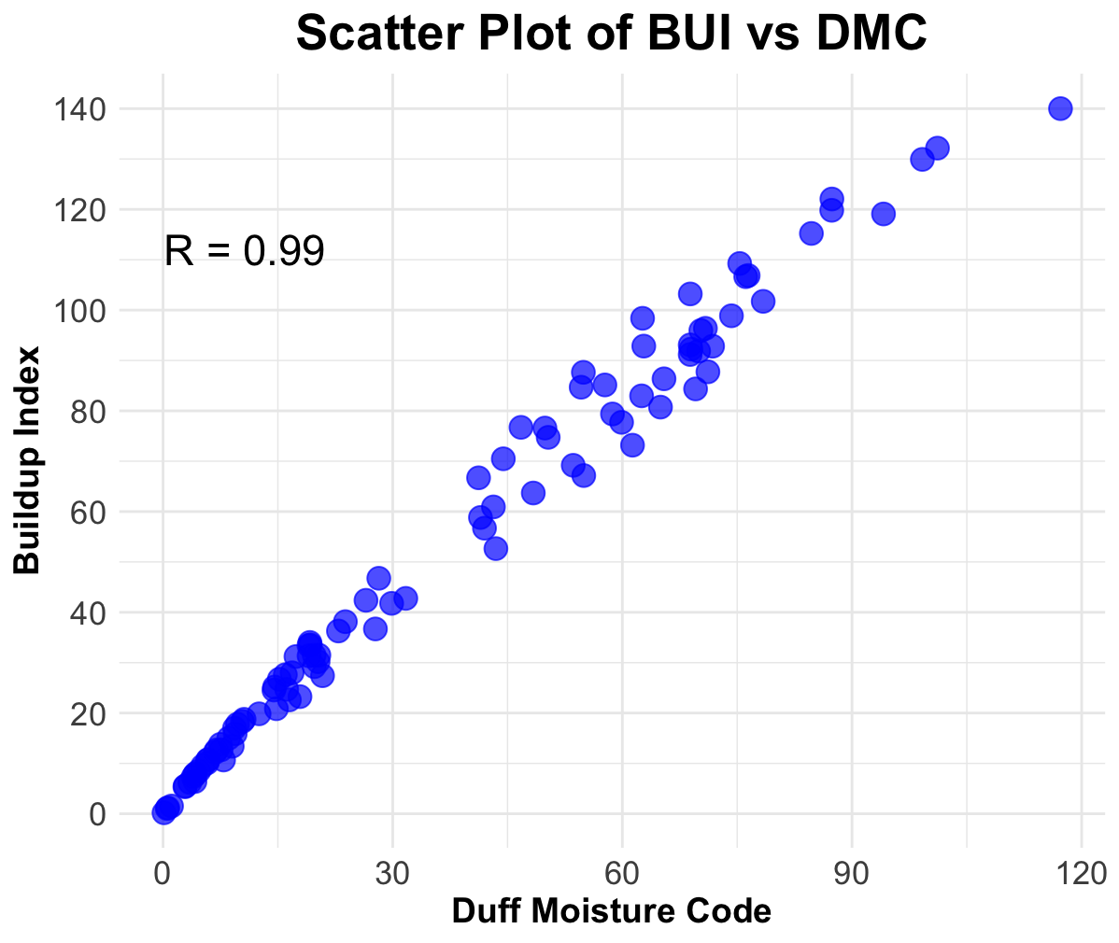
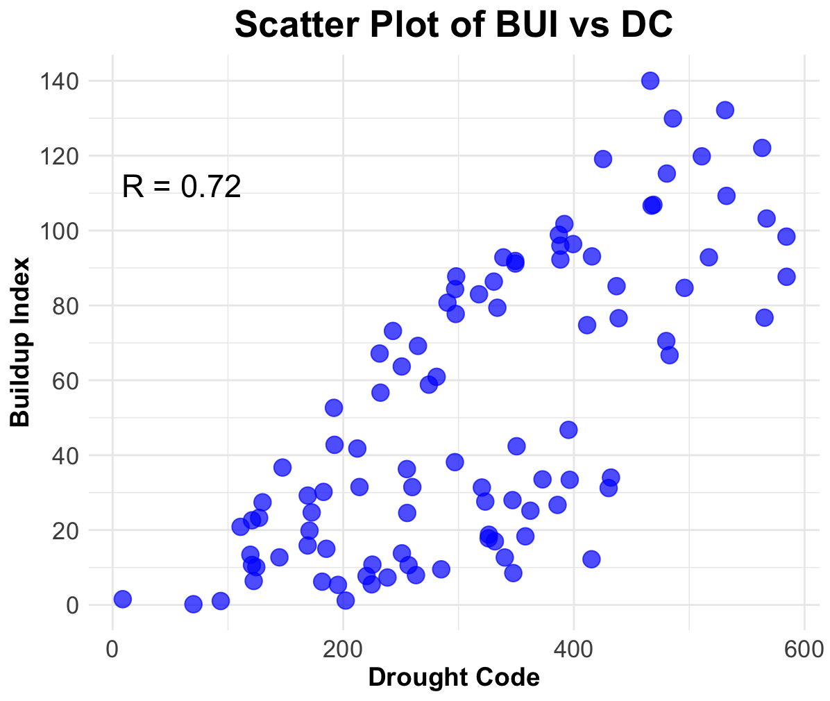
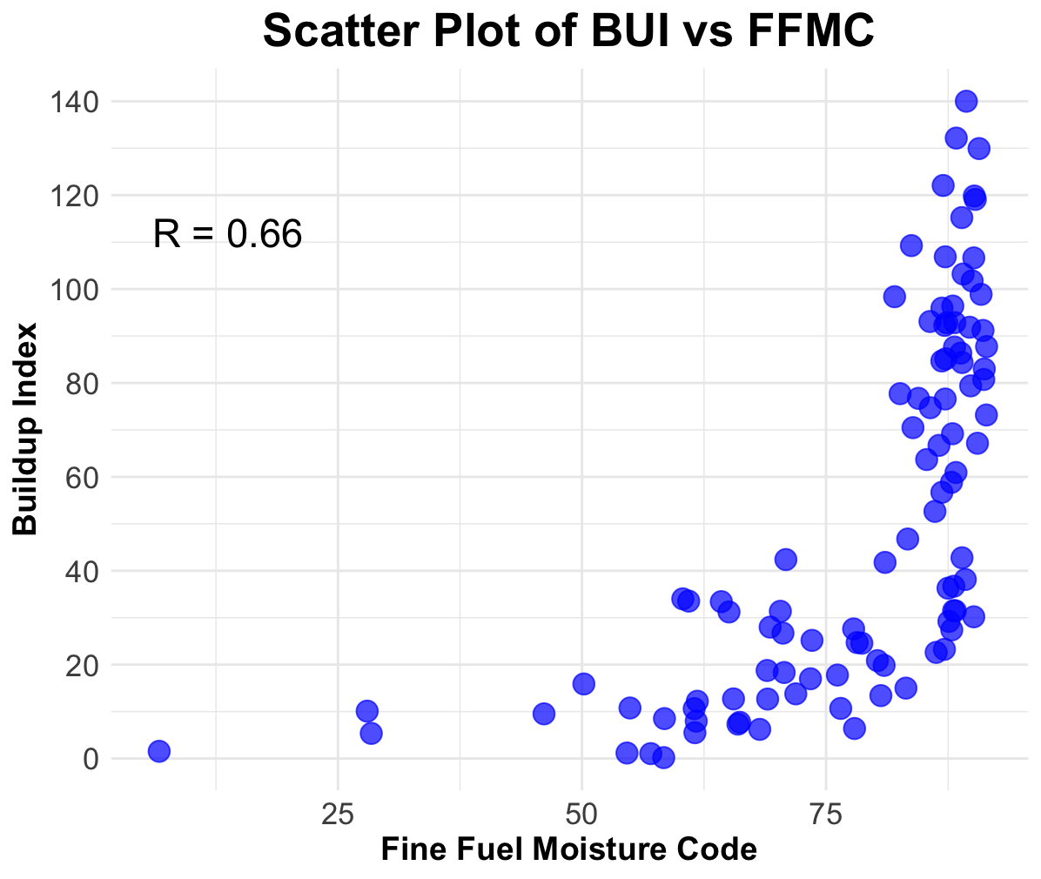
Scatter Plot for BUI vs. DMC/DC/FFMC
Page. 12
Notes:
The relationship between BUI and FFMC shows a moderate positive exponential correlation (R = 0.66). BUI and DMC, on the other hand, exhibit a strong positive linear correlation (R = 0.99), while BUI and DC show a moderate, relatively linear positive correlation (R = 0.72).

Slide 13
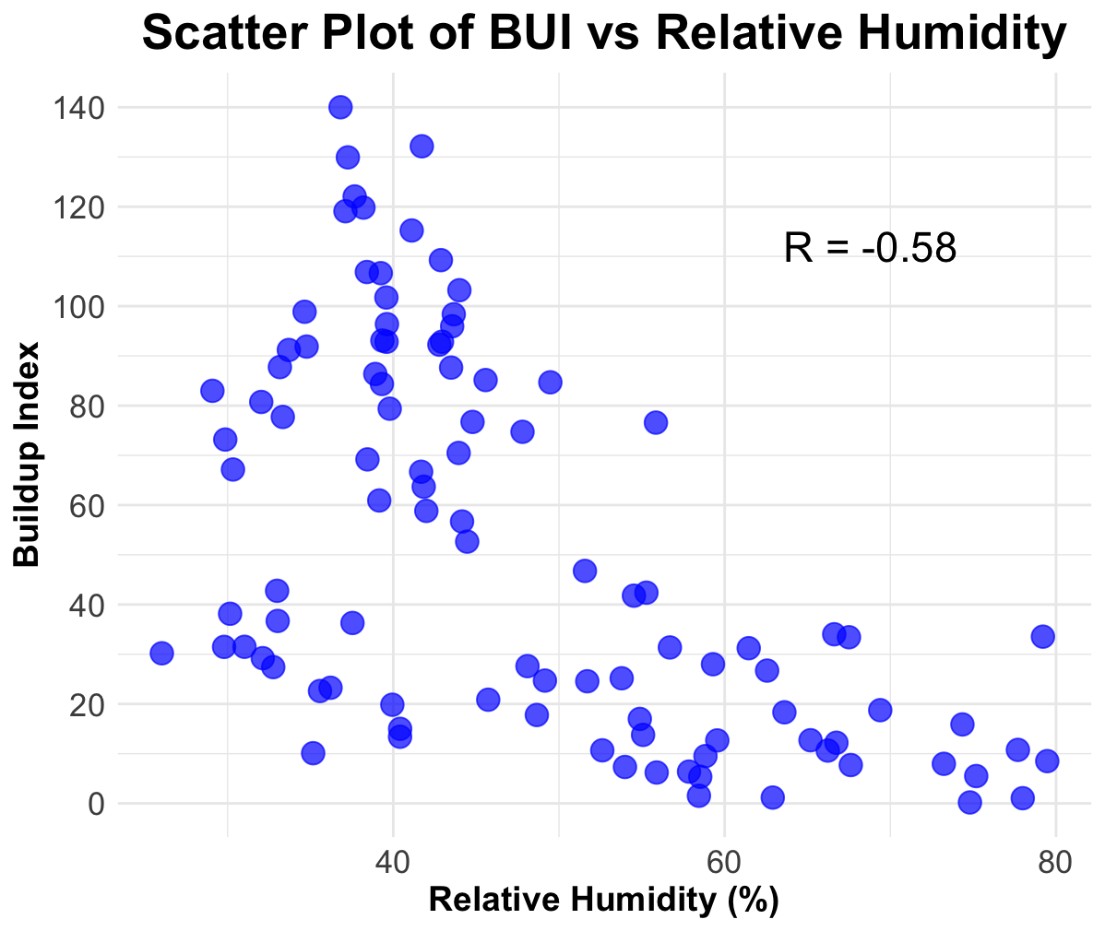
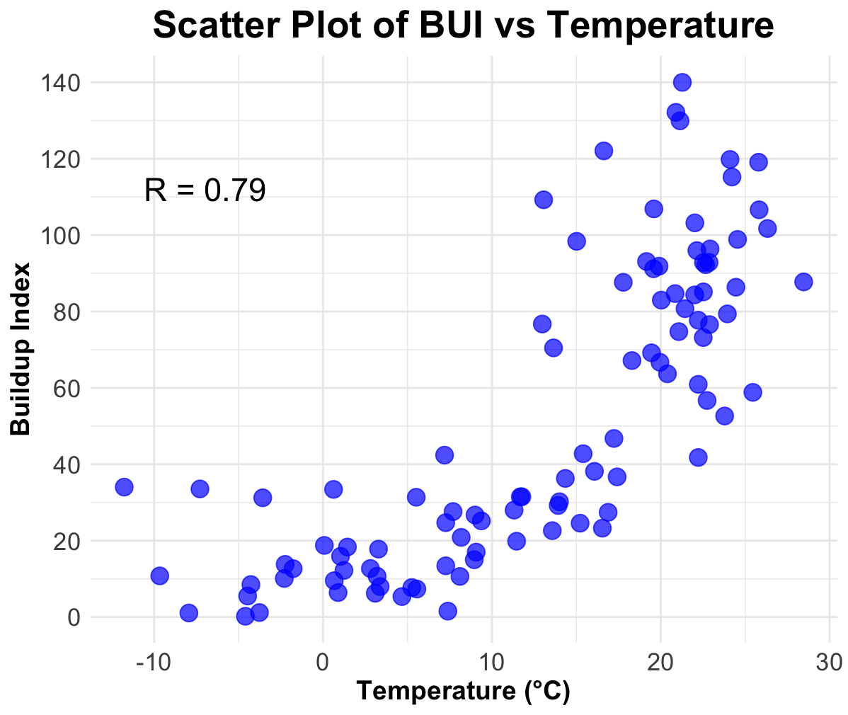
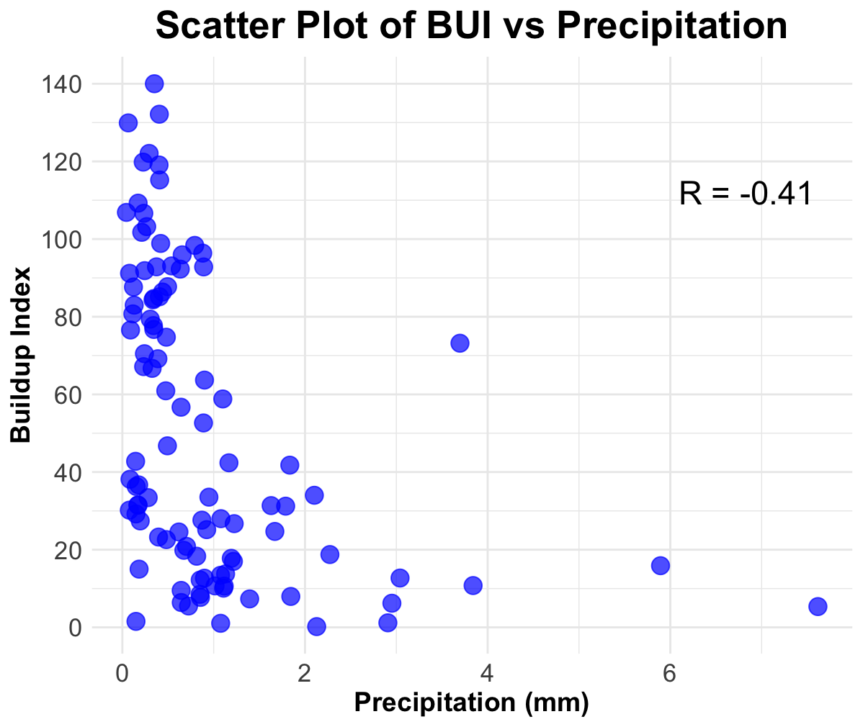
Scatter Plot for BUI vs. rh/Temp/pcp
Page. 13

Slide 14
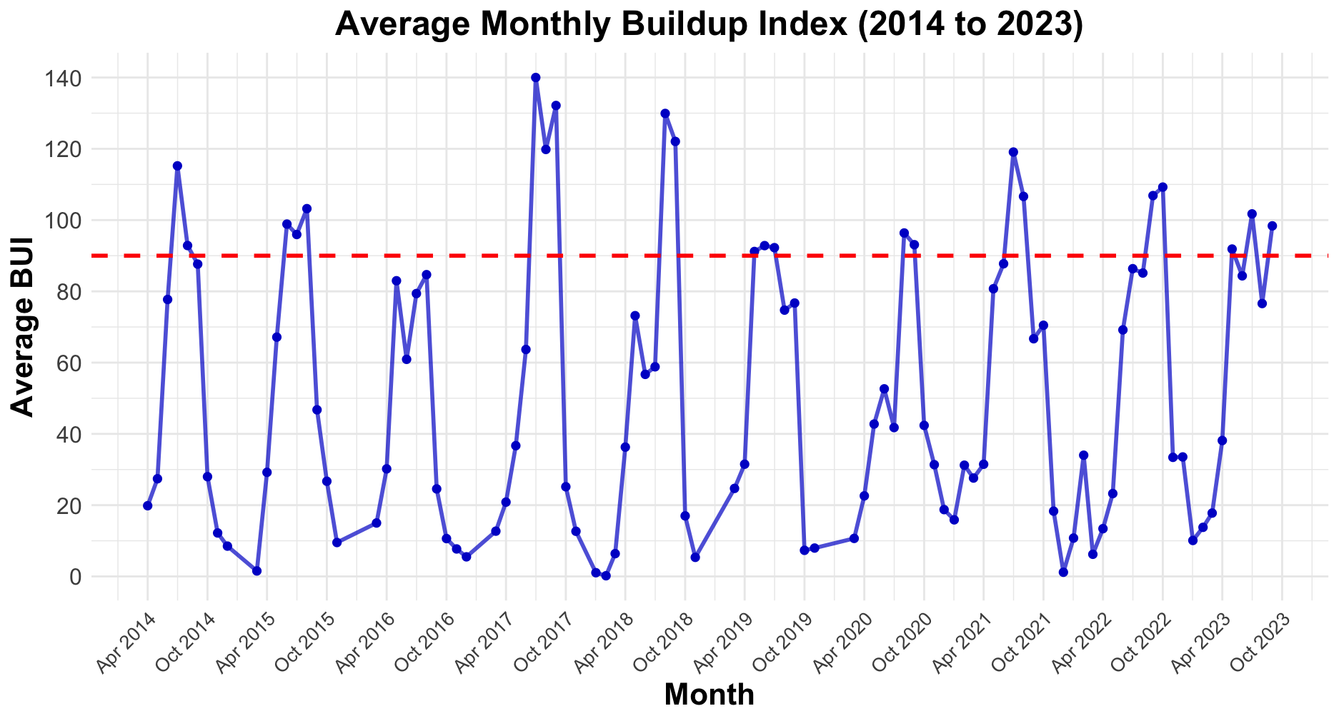
Time series of BUI
Page. 14
Notes:
Overall, this chart provides a visual representation of the historical Buildup index data. There's a clear seasonal pattern, with the BUI generally peaking in the late summer and early fall months (around October) and reaching its lowest point in the late winter and early spring (around April). This indicates during the late summer and early fall months, there might have potential large fire.
BUI is a numeric rating of the total amount of fuel available for combustion. It is a good indicator of large fire potential.
High BUI Periods: There were several periods with notably high BUI values, particularly in 2017, 2018, and 2021.
Low BUI Periods: Conversely, there were periods with consistently low BUI values, such as in 2016 and 2020.
These findings suggest that consistent monitoring of DMC and DC could be crucial in predicting the potential for large fires.

Slide 15
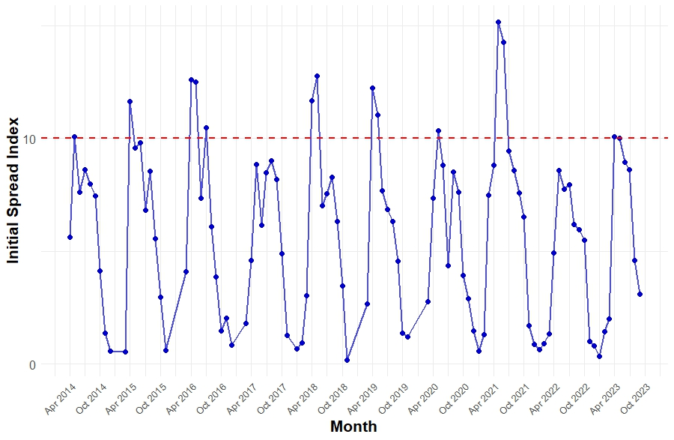
Time series of Initial spread index (ISI)
Page. 15
Notes:
Initial Spread Index
Shows a peak once a year representing warmer and drier seasons (late spring and summer) and more favorable for a fire spread.
Lower ISI values occurred during colder months (late fall and winter) resulting to reduced initial spread index.

Slide 16
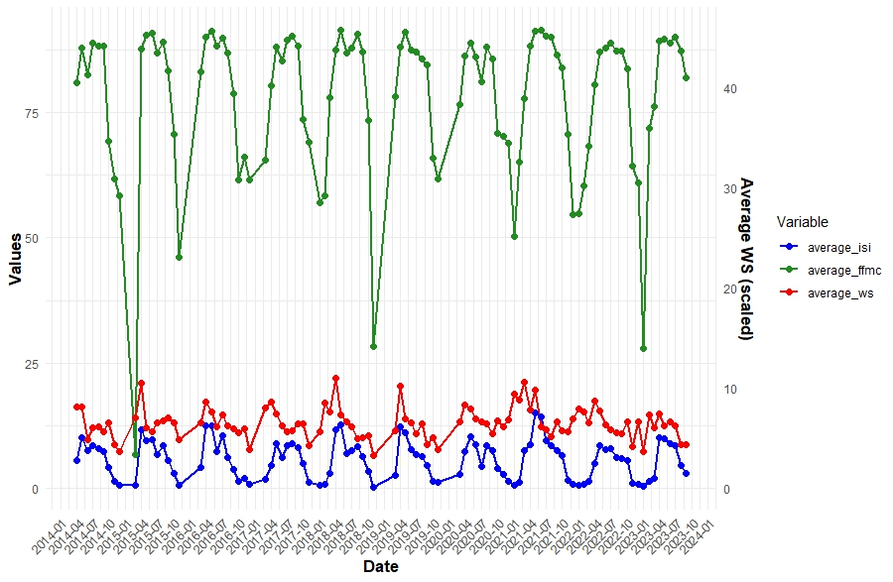
Key factors influencing ISI
Page. 16
Notes:
Fine Fuel Moisture Code and Wind Speed are the key players influencing the fire spread potential (ISI).
FFMC has direct relationship with ISI (R=0.78). When FFMC is high (drier condition), the rate of fire spread is more significant.
WS has weak relationship with ISI (R=0.38) but acts as amplifier of fire spread. Higher WS may slightly contribute to higher ISI .

Slide 17
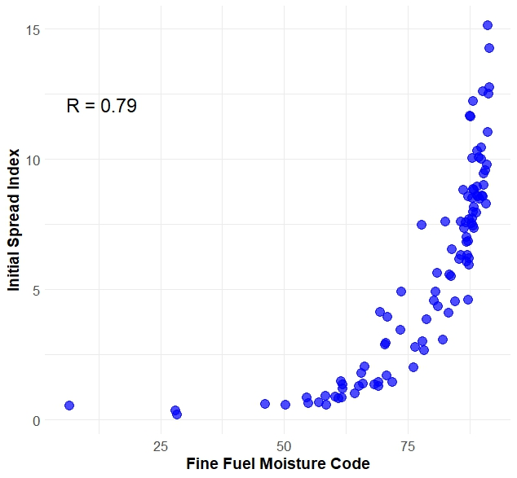
Scatter plot for ISI vs. FFMC
Page. 17
Notes:
ISI and FFMC
Positive correlation suggests that as FFMC increases, ISI increases rapidly.
The rate at which fire spread potential ISI increases becomes more significant at a certain thresholds of dryness in fine fuels
Fire Spread Potential: Higher FFMC indicates drier fine fuels and are more prone to ignition. The graph shows that as FFMC values reach 75, initial fire spread increases sharply.

Slide 18
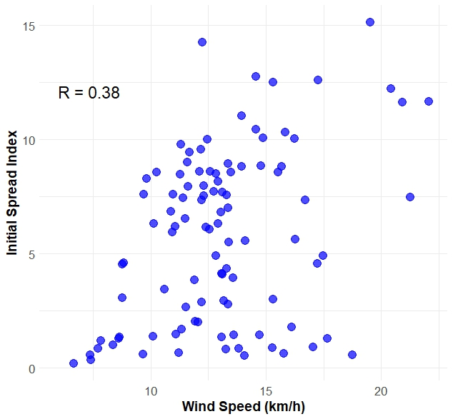
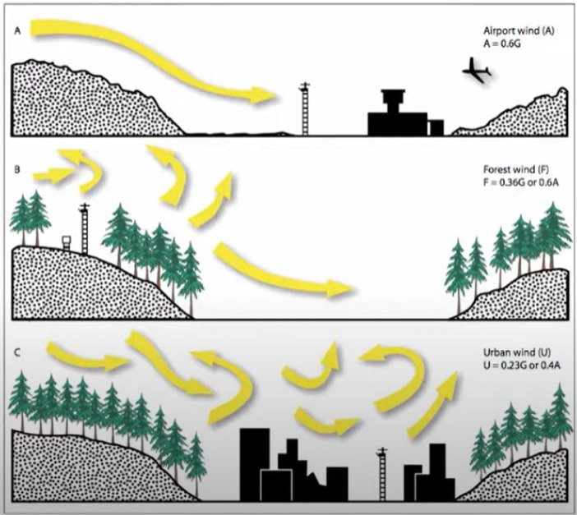
Scatter plot for ISI vs. Wind speed
Page. 18
Notes:
Photo credits: Photo of effect of slope in WS from Northwest Knowledge Hub ​
https://www.youtube.com/watch?v=4onekaD-J8M​
​
ISI and WS​
​
The relationship of ISI and WS is weak and inconsistent and suggests that wind speed alone does not strongly determines the fire spread potential.​
​
Variability of ISI at the same wind speeds suggests that other environmental factors (such as fuel moisture, temperature and humidity) play significant role in determining ISI. ​
​
Clustering of data points at wind speed between 10 – 15km/h indicates that wildfires in Canada often experience moderate wind speed conditions.​
​

Slide 19
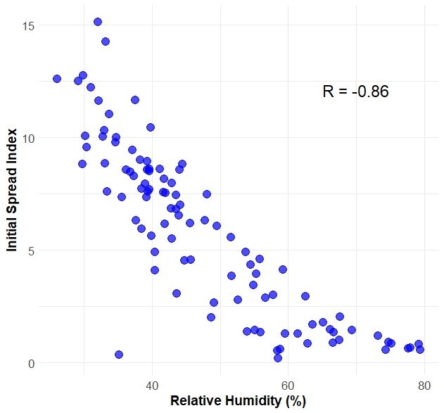
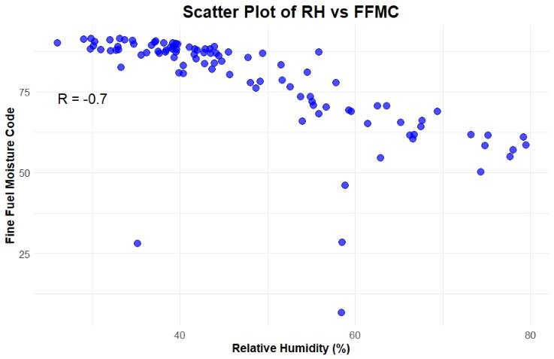
Scatter plot for ISI vs. Relative humidity
Scatter plot for FFMC vs. Relative humidity
Page. 19
Notes:
ISI and RH ​
​
Negative correlation or higher humidity is associated with lower fire spread potential.​
​
The sharp decline in ISI when RH is between 30% and 50% and slower decline beyond 50% indicate that once humidity reaches a certain level, it has a diminishing effect on reducing fore spread potential.​
​
RH is an early indicator of fire risk as dry air significantly heightens fire spreads potential.​
​

Slide 20
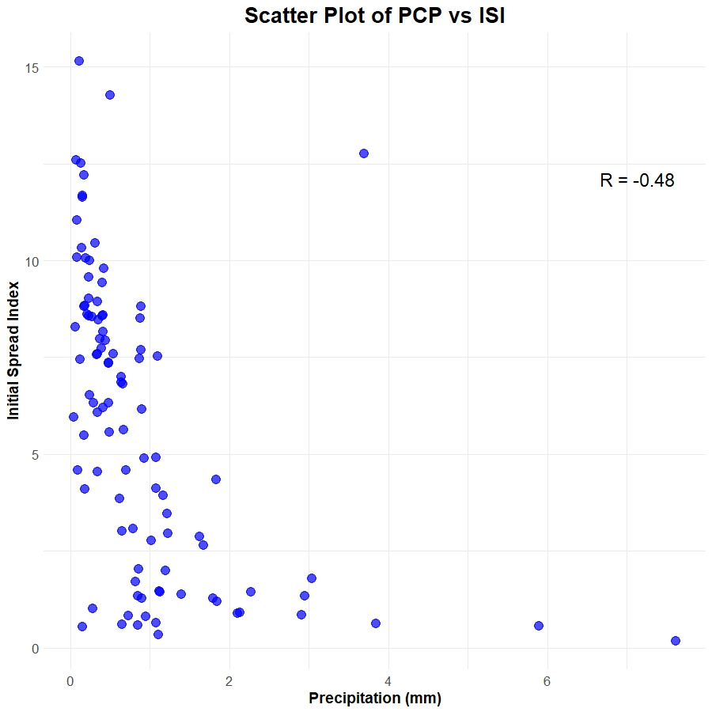
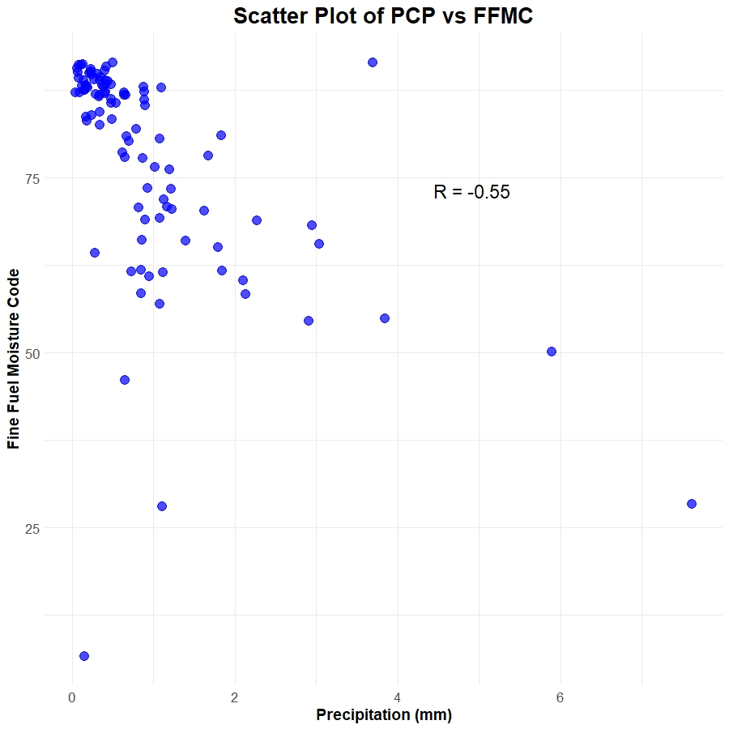
Scatter plot for ISI vs. PCP
Scatter plot for FFMC vs. PCP
Page. 20
Notes:
ISI and PCP ​
​
Higher rainfall reduces fire spread potential ​
​
The distribution of data points is skewed to the right, lower PCP, reflecting seasonal pattern or dry conditions at most of the months. ​
​
The variability of ISI between 0 to 1mm rainfall suggests that under dry conditions, factors other than precipitation might play a stronger role in influencing fire spread. ​

Slide 21

THANK YOU
FOR ATTENTION

